Slide 1
DLMS/COSEM transport layer for IP networks

Slide 2
SCOPE
Specifies a connection-less and a connection oriented transport layer (TL) for DLMS/COSEM communication profiles used on IP networks.
These TLs provide OSI-style services to the service user DLMS/COSEM AL.
The connection-less TL is based on the Internet Standard User Datagram Protocol (UDP).The connection-oriented TL is based on the Internet Standard Transmission Control Protocol(TCP).
Although the major part of the DLMS/COSEM TLs is the UDP and TCP,it also include an additional sublayer, called wrapper.

Slide 3
OVERVIEW
In the DLMS/COSEM_on_IP profiles, the DLMS/COSEM AL uses the services of one of these TLs, which use then the services of the Internet Protocol (IP) network layer to communicate with other nodes connected to the abstract IP network.
When used in these profiles, the DLMS/COSEM AL can be considered as another Internet standard application protocol (like the well-known HTTP, FTP or SNMP) and it may co-exist with other Internet application protocols, as it is shown in Fig.
For DLMS/COSEM, the following port numbers have been registered by the IANA. http://www.iana.org/assignments/port-numbers
dlms/cosem 4059/TCP DLMS/COSEM
dlms/cosem 4059/UDP DLMS/COSEM
Notes:
IANA : Acronym for Internet Assigned Number Authority
It is responsible for the global coordinetion of the DNS root,IP addressing and other IP resources.

Slide 4
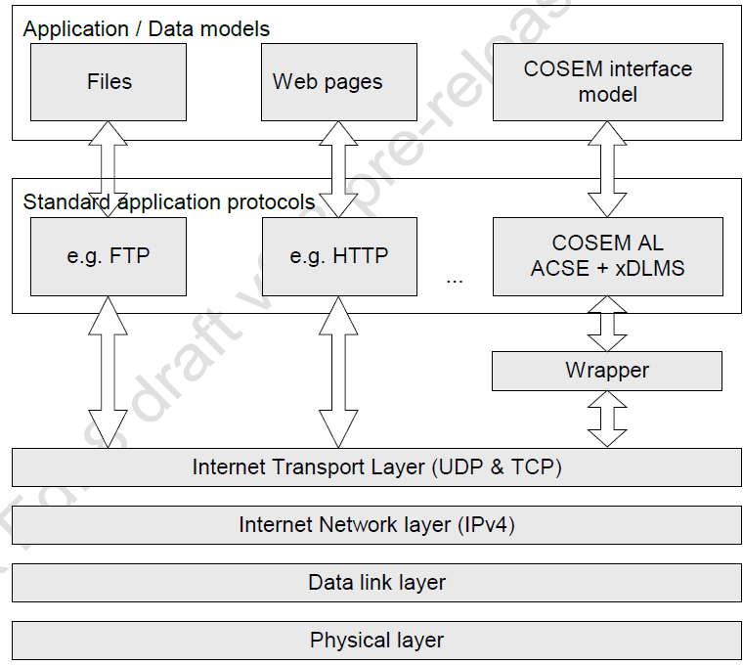
DLMS/COSEM as a standard Internet application protocol

Slide 5
The DLMS/COSEM TLs consist of a wrapper sublayer and the UDP or TCP TL.
The wrapper sublayer is a lightweight, nearly state-less entity:
Main function is to adapt the OSI-style service set, provided by the DLMS/COSEM TL, to UDP or TCP function calls and vice versa. In addition, the wrapper sublayer has the following functions:
It provides an additional addressing capability (wPort) on top of the UDP/TCP port
It provides information about the length of the data transported . This feature helps the sender to send and the receiver to recognize the reception of a complete APDU, which may be sent and received in multiple TCP packets.
Notes:
Stateless entity:
a communication protocol that treats each request as an independent transaction that is unrelated to any previous request so that the communication consists of independent pairs of request and response
Both TCP and UDP provide additional addressing capability at the transport level, called port, to distinguish between applications. The AL is listening only on one TCP or UDP port for exchanging messages between any client and server APs. As in a single physical device several client or server APs may be present, an additional addressing capability is needed. This is provided by the wrapper sublayer. The wrapper provides an identifier – wPort – similar to the TCP or UDP port numbers, but on the top of these layers. A particular COSEM client AP and/or a particular COSEM logical device in the same physical device can be thus identified by its wPort number.

Slide 6
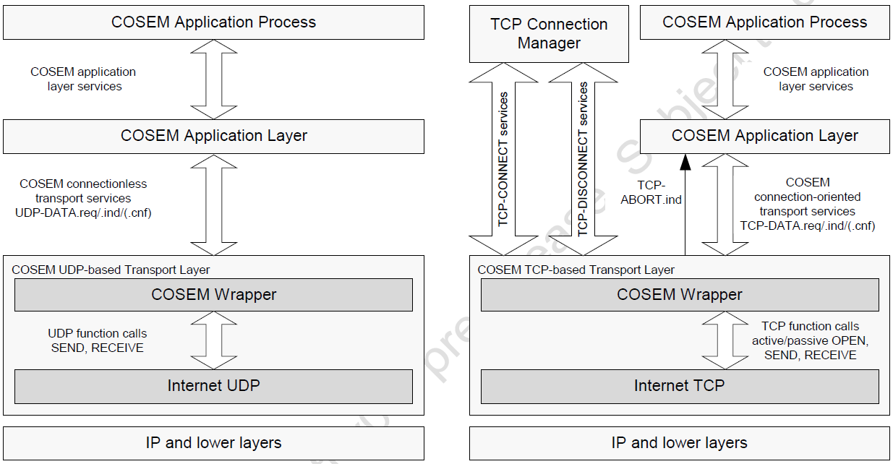
Transport layers of the DLMS/COSEM_on_IP profile

Slide 7
The DLMS/COSEM connection-less, UDP-based transport layer
UDP provides a procedure for application programs to send messages to other programs with a minimum of protocol mechanism.
It is transaction oriented, and delivery and duplicate protection are not guaranteed.
UDP is simple, it adds a minimum of overhead, and it is efficient and easy to use.
Another advantage of UDP is that being connection-less, it is easily capable of multi- and broadcasting.
UDP basically provides an upper interface to the IP layer, with an additional identification capability, the UDP port number. This allows distinguishing between APs, hosted in the same physical device and identified by its IP address.
Notes:
Several well-known Internet applications, like SNMP, DHCP, TFTP, etc. take advantage of these performance benefits, either because some datagram applications do not need to be reliable or because the required reliability mechanism is ensured by the application itself.
Request/response type applications, like a confirmed COSEM application association established on the DLMS/COSEM UDP-based TL, then invoking confirmed xDLMS data transfer services is a good example for this second category.

Slide 8
Service specification for the DLMS/COSEM UDP-based transport layer
The DLMS/COSEM UDP-based TL provides only a data transfer service: the connection-less UDP-DATA service. Consequently, the service specification for this service is the same for both the client and server TLs, as it is shown in Figure.
The .request and .indication service primitives are mandatory. The implementation of the local .confirm service primitive is optional.
The xDLMS APDU pre-fixed with the wrapper header shall fit in a single UDP datagram.

Slide 9
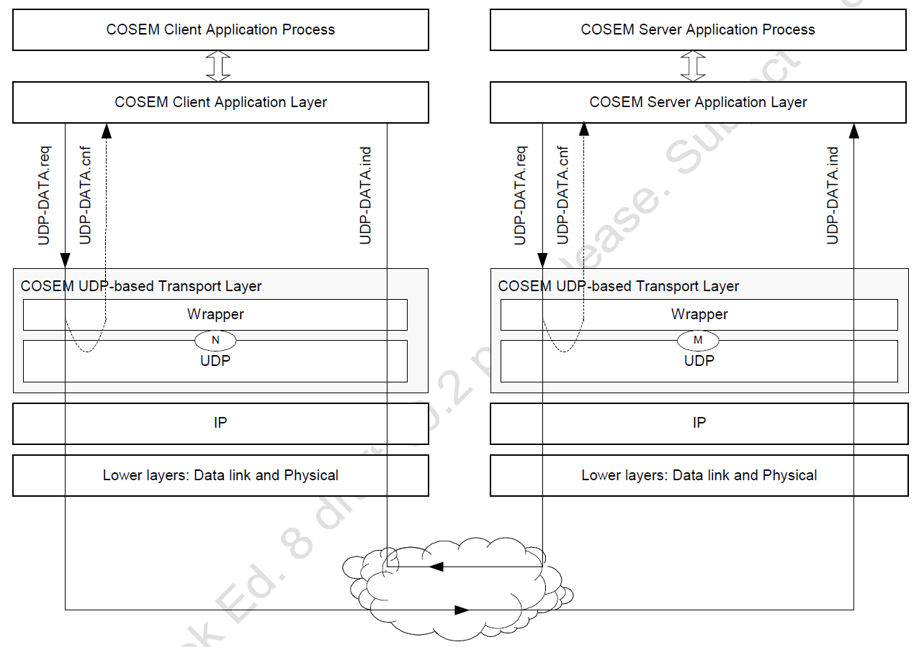
Services of the DLMS/COSEM connection-less, UDP-based transport layer

Slide 10
The UDP-DATA service
UDP-DATA.request :
Function :
This primitive is the service request primitive for the connection-less mode data transfer service.
Semantics of the service primitive :
UDP-DATA.request
(
Local_wPort,
Remote_wPort,
Local_UDP_Port,
Remote_UDP_Port,
Local_IP_Address,
Remote_IP_Address,
Data_Length,
Data
)
Notes:
T
The Local_wPort, Local_UDP_Port and Local_IP_Address parameters indicate wrapper Port number, UDP Port number and IP Address parameters belonging to the device / DLMS/COSEM AE requesting to send the Data.
The Remote_wPort, Remote_UDP_Port and Remote_IP_Address parameters indicate the wrapper Port number, UDP Port number and IP Address parameters belonging to the device / DLMS/COSEM AE to which the Data is to be transmitted.
The Data_Length parameter indicates the length of the Data parameter in bytes.
The Data parameter contains the xDLMS APDU to be transferred to the peer AL.

Slide 11
Use:
The UDP-DATA.request primitive is invoked by either the client or the server DLMS/COSEM AL to request sending an APDU to a single peer AL, or, in the case of multi- or broadcasting, to multiple peer Als.
The reception of this service primitive shall cause the wrapper sublayer to pre-fix the wrapper header to the APDU received, and then to call the SEND() function of the UDP sublayer with the properly formed WPDU,as DATA.
The UDP sublayer shall transmit the WPDU to the peer wrapper sublayer as described in STD0006

Slide 12
UDP-DATA.indication
Function :
This primitive is the service indication primitive for the connection-less mode data transfer service.
Semantics of the service primitive :
UDP-DATA.indication
(
Local_wPort,
Remote_wPort,
Local_UDP_Port,
Remote_UDP_Port,
Local_IP_Address,
Remote_IP_Address,
Data_Length,
Data
)
Notes:
The Local_wPort, Local_UDP_Port and Local_IP_Address parameters indicate wrapper Port number, UDP Port number and IP Address parameters belonging to the device / DLMS/COSEM AE receiving the Data.
The Remote_wPort, Remote_UDP_Port and Remote_IP_Address parameters indicate the wrapper Port number, UDP Port number and IP Address parameters belonging to the device / AP, which has sent the data.
The Data_Length parameter indicates the length of the Data parameter in bytes.
The Data parameter contains the xDLMS APDU received from the peer AL.

Slide 13
Use :
The UDP-DATA.indication primitive is generated by the DLMS/COSEM UDP based TL to indicate to the service user DLMS/COSEM AL that an APDU from the peer layer entity has been received.
The primitive is generated following the reception of an UDP Datagram by the UDP sublayer, if both the Local_UDP_Port and Local_wPort parameters of the message received contain valid port numbers, meaning that there is a DLMS/COSEM AE in the receiving device bound to the given port numbers.
Otherwise, the message received shall simply be discarded.

Slide 14
UDP-DATA.confirm
Function :
This primitive is the optional service confirm primitive for connection-less mode data transfer service.
Semantics of the service primitive :
UDP-DATA.confirm
(
Local_wPort,
Remote_wPort,
Local_UDP_Port,
Remote_UDP_Port,
Local_IP_Address,
Remote_IP_Address,
Result
)
Notes:
The Local_wPort, Remote_wPort, Local_UDP_Port,Remote_UDP_Port, Local_IP_Address andRemote_IP_Address parameters carry the same values as the corresponding UDP-DATA.request service being confirmed.
The value of the Result parameter indicates whether the DLMS/COSEM UDP-based TL was able to send the requested UDP Datagram (OK) or not (NOK).

Slide 15
Use :
The UDP-DATA.confirm primitive is optional. If implemented, it is generated by the DLMS/COSEM TL to confirm to the service user DLMS/COSEM AL the result of the previous UDP-DATA.request. It is locally generated and indicates only whether the Data in the .request primitive could be sent or not.
An UDP-DATA.confirm with Result == OK means only that the Data has been sent, and does not mean that the Data has been (or will be) successfully delivered to the destination.

Slide 16
Protocol specification for the DLMS/COSEM UDP-based transport layer
DLMS/COSEM-specific light-weight wrapper sublayer
The wrapper sublayer is a state-less entity.
Its only roles are::
Ensure source and destination DLMS/COSEM AE identification using the wPort numbers.
And provide conversion between the OSI-style UDP-DATA.xxx service invocations and the SEND() and RECEIVE() interface functions provided by the standard UDP.
Notes:
Stateless entity::a communications protocol that treats each request as an independent transaction that is unrelated to any previous request so that the communication consists of independent pairs of request and response
Although it is not necessary in the UDP-based profile, in order to have the same wrapper protocol control information – in other words the wrapper header – in both TLs, the wrapper sublayer shall also include the Data Length information in the wrapper protocol data unit.

Slide 17
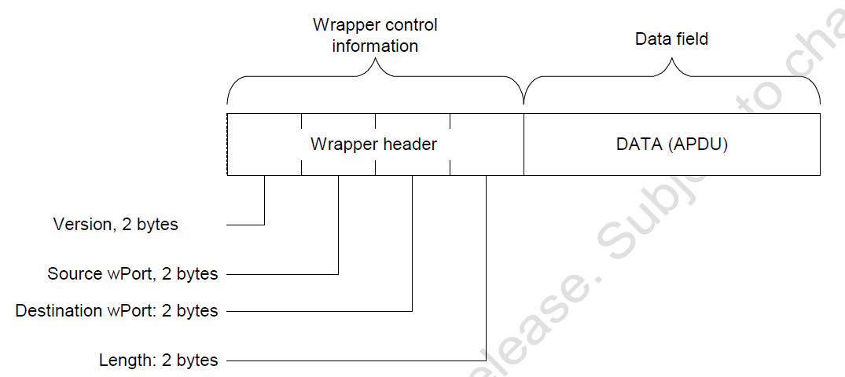
The wrapper protocol data unit (WPDU)
The WPDU consists of two parts:
The wrapper header part, containing the wrapper control information.
The data part, containing the DATA parameter – an xDLMS APDU – of the corresponding UDP-DATA.xxx service invocation.
The wrapper header includes four fields, see Figure. Each field is a 16 bit long unsigned integer value.
Notes:
The wrapper header includes four fields, see Figure. Each field is a 16 bit long unsigned integer value.
• Version: carries the version of the wrapper. Its value is controlled by the DLMS UA. The current value is 0x0001. Note, that in later versions the wrapper header may have a different structure
Source wPort: carries the wPort number identifying the sender DLMS/COSEM AE;
• Destination wPort: carries the wPort number identifying the DLMS/COSEM AE;
• Data length: indicates the length of the DATA field of the WPDU (the xDLMS APDU transported).
NOTE :: The maximum length of the APDU should be eight bytes less than the maximum length of the UDP datagram.

Slide 18
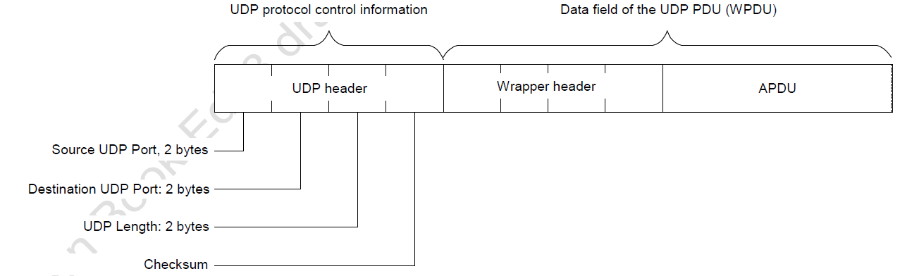
The DLMS/COSEM UDP-based transport layer protocol data unit
In this profile, WPDUs shall be transmitted in UDP Datagrams, specified in Internet standard STD0006. They shall encapsulate the WPDU, as shown in Figure
Notes:
From the external point of view, the DLMS/COSEM connection-less TL PDU is an ordinary UDP Datagram: any DLMS/COSEM specific element, including the wrapper-specific header is inside the UDP Data field.
Consequently, standard UDP implementations can be (re-)used to easily implement this TL.
The Source and Destination UDP ports may refer to either local or remote UDP ports depending on the direction of the data transfer: from the point of view of the sending device the Source UDP port in a Datagram corresponds to the Local_UDP_port, but from the point of view of the receiving device the Source UDP port in a Datagram corresponds to the Remote_UDP_Port service parameter.
According to the UDP specification, filling the source UDP Port and Checksum fields with real data is optional. A zero value – all bits are equal to zero – of these fields indicates that in the given UDP Datagram the field is not used. However, in the DLMS/COSEM_on_IP profile, the source UDP Port field shall always be filled with the source UDP port number.

Slide 19
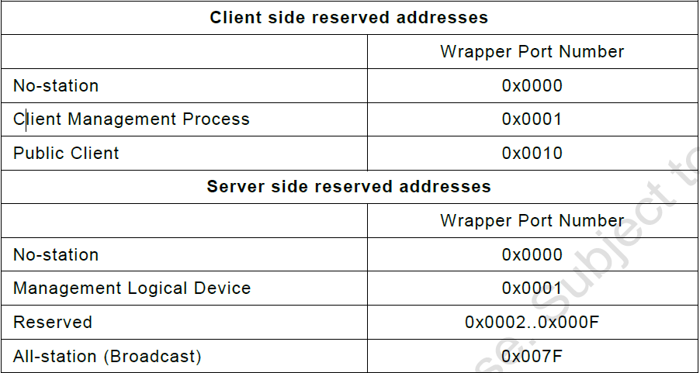
Reserved wrapper port numbers (wPorts)
Notes:
reserved one is used for future purpose.
for client management process::
Events in the server may occur any time and they have to be reported to the client. This is always done by the server management logical device (address 0x01) to the client management application process (address 0x01).

Slide 20
Protocol state machine
As the wrapper sublayer in this profile is state-less, for all other protocol related issues – protocol state machine, etc. – the governing rules are as they are specified in the Internet standard STD0006.
The only supplementary rule is concerning discarding inappropriate messages: messages with an invalid destination wPort number
There is no DLMS/COSEM AE in the receiving device bound to this wPort number – shall be discarded by the wrapper sublayer.

Slide 21
The DLMS/COSEM connection-oriented, TCP-based transport layer
The DLMS/COSEM connection-oriented TL is based on the connection-oriented Internet transport protocol, called Transmission Control Protocol.
TCP is an end-to-end reliable protocol.
This reliability is ensured by a conceptual “virtual circuit”, using a method called PAR,
Positive Acknowledgement with Retransmission.
It provides acknowledged data delivery, error detection, data re-transmission after an acknowledgement time-out, etc. Therefore it deals with lost, delayed, duplicated or
erroneous data packets. In addition, TCP offers an efficient flow control mechanism and
full-duplex operation, too.

Slide 22
TCP, as a connection-oriented transfer protocol involves three phases: connection establishment, data exchange and connection release.
Consequently, the DLMS/COSEM TCP-based TL provides OSI-style services to the service user(s) for all three phases:
For the connection establishment phase, the TCP-CONNECT service is provided to the service user TCP connection manager process;
For the data transfer phase, the TCP-DATA service is provided to the service user DLMS/COSEM AL;
For the connection closing phase, the TCP-DISCONNECT service is provided to the service user TCP connection manager process;
In addition, a TCP-ABORT service is provided to the service user DLMS/COSEM AL.
Notes:
The DLMS/COSEM connection-oriented, TCP-based TL contains the same wrapper sublayer as the DLMS/COSEM UDP-based TL. In addition to transforming OSI-style services to and from TCP function calls, this wrapper provides additional addressing and length information.
The DLMS/COSEM connection-oriented, TCP-based TL is specified in terms of services and protocols. The conversion between OSI-style services and TCP function calls is presented in later .

Slide 23
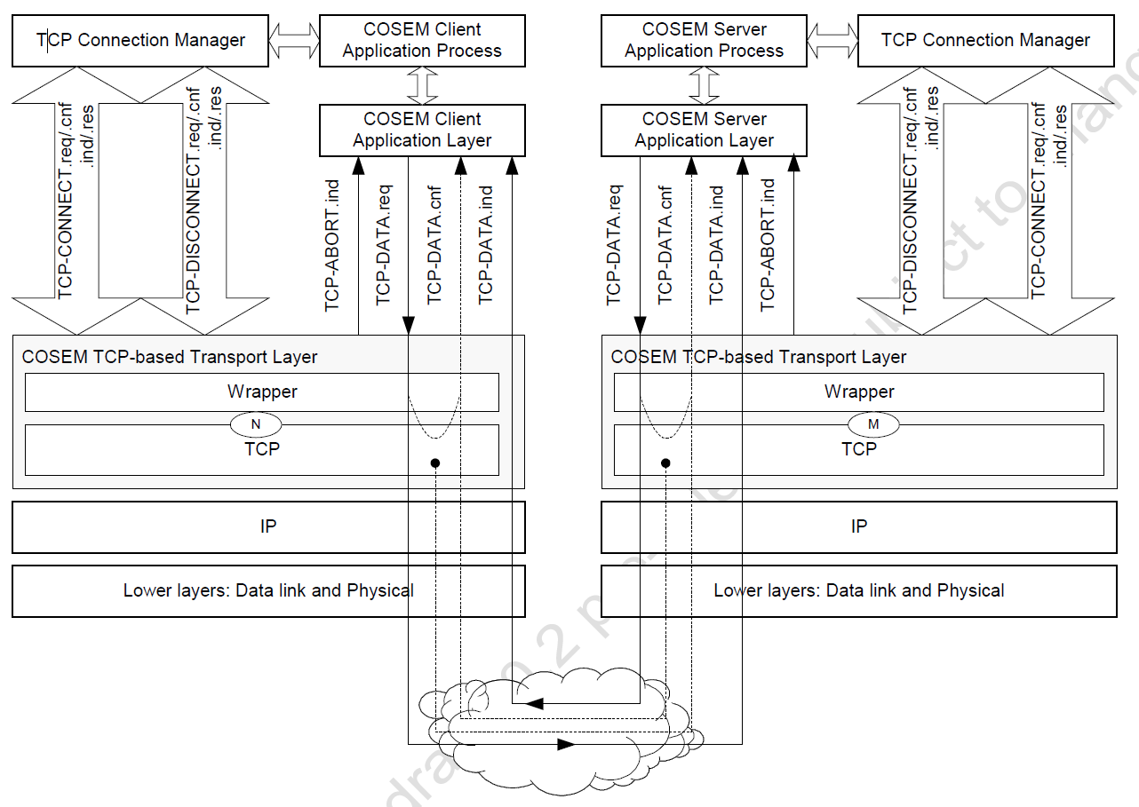
Service specification for the DLMS/COSEM TCP-based transport layer
Notes:
In this communication profile, the full set of the service
primitives of the TCP connection management services (TCP-CONNECT and TCP-DISCONNECT) is provided both at the client- and at the server sides. This is to allow the server initiating and releasing a TCP connection, too
The service user of the TCP connection management services is not the DLMS/COSEM AL, but the TCP connection manager process. The specification of this process is out of the scope of this companion specification; however, the DLMS/COSEM AL sets some requirements concerning this.
An additional COSEM-ABORT service is provided to indicate to the COSEM AL the disruption or disconnection of supporting TCP connection.
Like in the DLMS/COSEM UDP-based TL, the TCP-
DATA.confirm service primitive is also optional.
However, the TCP-DATA.request service can be confirmed either locally or remotely

Slide 24
The TCP-CONNECT service
TCP-CONNECT.request
Function
This primitive is the service request primitive for the connection establishment service.
Semantics of the service primitive
TCP-CONNECT.request
(
Local_TCP_Port,
Remote_TCP_Port,
Remote_IP_Address
)
Use :
The TCP-CONNECT.request primitive is invoked by the service user TCP connection manager process to establish a connection with the peer DLMS/COSEM TCP-based TL.
Notes:
The Local_TCP_Port and Remote_TCP_Port parameters identify the local and remote TCP ports respectively. The Local_IP_Address and Remote_IP_Address parameters indicate the IP Address of the physical device requesting the TCP connection and of the target physical device, to which the TCP connection requested is to be established.

Slide 25
TCP-CONNECT.indication
Function
This primitive is the service indication primitive for the connection establishment service.
Semantics of the service primitive
TCP-CONNECT.indication
(
Local_TCP_Port,
Remote_TCP_Port,
Local_IP_Address,
Remote_IP_Address
)
Use
The TCP-CONNECT.indication primitive is generated by the DLMS/COSEM TCP-based TL following the reception of a TCP packet, indicating to the TCP connection manager process that a remote device is requesting a new TCP connection.
Notes:
The Local_TCP_Port and Remote_TCP_Port parameters indicate the two TCP ports between which the requested TCP connection is to be established. The Local_IP_Address and Remote_IP_Address parameters indicate the IP addresses of the two devices participating in the TCP connection.

Slide 26
TCP-CONNECT.response
Function
This primitive is the service response primitive for the connection establishment service.
Semantics of the service primitive
TCP-CONNECT.response
(
Local_TCP_Port,
Remote_TCP_Port,
Local_IP_Address,
Remote_IP_Address,
Result
)
USE:
The TCP-CONNECT.response primitive is invoked by the TCP connection manager process to indicate to the DLMS/COSEM TCP-based TL whether the TCP connection requested previously has been accepted. The TCP connection manager cannot reject a requested connection.
Notes:
The Local_TCP_Port and Remote_TCP_Port parameters indicate the two TCP ports between which the connection is being established. The Local_IP_Address and Remote_IP_Address parameters indicate the IP addresses of the two physical devices participating in the TCP connection.
The Result parameter indicates that the service user TCP connection manager has accepted the requested TCP connection. Its value is always SUCCESS.

Slide 27
TCP-CONNECT.confirm
Function
This primitive is the service confirm primitive for the connection establishment service.
Semantics of the service primitive
TCP-CONNECT.confirm
(
Local_TCP_Port,
Remote_TCP_Port,
Local_IP_Address,
Remote_IP_Address,
Result,
Reason_of_Failure
)
Use
The TCP-CONNECT.confirm primitive is generated by the DLMS/COSEM TCP-based TL to indicate to the service user TCP connection manager process the result of a TCP-CONNECT.request service invocation received previously.
Notes:
The Local_TCP_Port and Remote_TCP_Port parameters indicate the two TCP ports between which 2310 the connection is being established. The Local_IP_Address and Remote_IP_Address parameters indicate the IP addresses of the two physical devices participating in this TCP connection.
The Result parameter indicates, whether the requested TCP connection is established or not. Note, that this service primitive is normally the result of a remote confirmation – and as a TCP connection request cannot be rejected, the Result parameter shall always indicate SUCCESS
However, the Result parameter may also indicate FAILURE, when it is locally confirmed. In this case the Reason_of_Failure parameter indicates the reason for the failure.

Slide 28
TCP-DISCONNECT.request
Function
This primitive is the service request primitive for the connection termination service.
Semantics of the service primitive
TCP-DISCONNECT.request
(
Local_TCP_Port,
Remote_TCP_Port,
Local_IP_Address,
Remote_IP_Address
)
Use
The TCP-DISCONNECT.request primitive is invoked by the service user TCP connection manager process to request the disconnection of an existing TCP connection.
Notes:
The service parameters are the identifiers of the TCP connection to be released. The Local_TCP_Port and Local_IP_Address parameters designate the local TCP port and IP Address of the requesting device and application, the Remote_IP_Address and Remote_TCP_Port parameters refer to the remote device and application.

Slide 29
TCP-DISCONNECT.indication
Function
This primitive is the service indication primitive for the connection termination service.
Semantics of the service primitive
TCP-DISCONNECT.indication
(
Local_TCP_Port,
Remote_TCP_Port,
Local_IP_Address,
Remote_IP_Address,
Reason
)
Use
The TCP-DISCONNECT.indication primitive is generated by the DLMS/COSEM TCP-based TL to the service user TCP connection manager process to indicate that the peer entity has requested the disconnection of an existing TCP connection.
Notes:
The same primitive is used also to indicate if the TL detects a non-solicited disconnection of an existing TCP connection (for example, when the physical connection breaks down)

Slide 30
TCP-DISCONNECT.response
Function
This primitive is the service response primitive for the connection termination service.
TCP-DISCONNECT.response
(
Local_TCP_Port,
Remote_TCP_Port,
Local_IP_Address,
Remote_IP_Address,
Result
)
Use
The TCP-DISCONNECT.response primitive is invoked by the TCP connection manager process to indicate to the DLMS/COSEM TCP-based TL whether the previously requested TCP disconnection is accepted.
The TCP connection manager process cannot reject the requested disconnection. This service primitive is invoked only if the corresponding TCP-DISCONNECT.indication service indicated a remotely initiated disconnection request (Reason == REMOTE_REQ).
Notes:
The Local_TCP_Port and Remote_TCP_Port parameters identify the two TCP ports between which 2377 the TCP connection has to be disconnected. The Local_IP_Address and Remote_IP_Address 2378 parameters indicate the IP addresses of the two physical devices participating in the TCP connection 2379 to be disconnected. 2380
The Result parameter indicates that the service user TCP connection manager process has accepted 2381 to disconnect the TCP connection referenced. The value of this parameter is always SUCCESS

Slide 31
TCP-DISCONNECT.confirm
Function
This primitive is the service confirm primitive for the connection termination service.
Semantics of the service primitive
TCP-DISCONNECT.confirm
(
Local_TCP_Port,
Remote_TCP_Port
Local_IP_Address,
Remote_IP_Address,
Result,
Reason_of_Failure
)
Use
The TCP-DISCONNECT.confirm primitive is invoked by the DLMS/COSEM TCP-based TL to confirm to the service user TCP connection manager the result of a previous TCP-DISCONNECT.request service invocation.
Notes:
The Local_TCP_Port and Remote_TCP_Port parameters identify the two TCP ports between which the TCP connection has to be disconnected. The Local_IP_Address and Remote_IP_Address parameters indicate the IP addresses of the two physical devices participating in the TCP connection to be disconnected.
The Result parameter indicates, whether the disconnection of the TCP connection referenced has succeeded or not. Normally, this service primitive is invoked as the result of a remote confirmation, and as a TCP disconnection request cannot be rejected, the value of the Result parameter is always SUCCESS.
However, the Result parameter may also indicate FAILURE, when it is locally confirmed. In this case the Reason_of_Failure parameter indicates the reason of the failure.

Slide 32
The TCP-ABORT service
TCP-ABORT.indication
Function
This primitive is the service indication primitive for the connection termination service.
Semantics of the service primitive
TCP-ABORT.indication
(
Local_TCP_Port,
Remote_TCP_Port,
Local_IP_Address,
Remote_IP_Address,
Reason
)
Use
The TCP-ABORT.indication primitive is generated by the DLMS/COSEM TCP-based TL to indicate to the service user DLMS/COSEM AL a non-solicited disruption of the supporting TCP connection.
When this indication is received, the DLMS/COSEM AL shall release all AAs established using this TCP connection, and shall indicate this to the COSEM AP using the COSEM-ABORT.indication service primitive. .
Notes:
The Local_TCP_Port and Remote_TCP_Port parameters identify the two TCP ports the connection between which has aborted. The Local_IP_Address and Remote_IP_Address parameters indicate the IP addresses of the two physical devices having been participated in the TCP connection aborted.
The Reason parameter indicates the reason of the TCP abort. This parameter is optional.

Slide 33
The TCP-DATA service
TCP-DATA.request
Function
This primitive is the service request primitive for the connection mode data transfer service.
Semantics of the service primitive
TCP-DATA.request
(
Local_wPort,
Remote_wPort,
Local_TCP_Port,
Remote_TCP_Port,
Local_IP_Address,
Remote_IP_Address,
Data_Length,
Data
)
Use
The TCP-DATA.request primitive is invoked by either the client or the server DLMS/COSEM AL to request sending an APDU to a single peer application.
The reception of this primitive shall cause the wrapper sublayer to pre-fix the wrapper-specific fields (Local_wPort, Remote_wPort and the Data_Length) to the xDLMS APDU received, and then to call the SEND() function of the TCP sublayer with the properly formed WPDU, as DATA.
Notes:
The Local_wPort, Local_TCP_Port and Local_IP_Address parameters indicate wrapper Port number, TCP Port number and IP Address parameters of the device / DLMS/COSEM AE requesting to send the Data. The Remote_wPort, Remote_TCP_Port and Remote_IP_Address parameters indicate the wrapper Port number, TCP Port number and IP Address parameters belonging to the device / DLMS/COSEM AE to which the Data is to be transmitted.
The Data_Length parameter indicates the length of the Data parameter in bytes.
The Data parameter contains the xDLMS APDU to be transferred to the peer AL.

Slide 34
TCP-DATA.indication
Function
This primitive is the service request primitive for the connection mode data transfer service.
Semantics of the service primitive :
TCP-DATA.indication
(
Local_wPort,
Remote_wPort,
Local_TCP_Port,
Remote_TCP_Port,
Local_IP_Address,
Remote_IP_Address,
Data_Length,
Data
)
Notes:
The Local_wPort, Local_TCP_Port and Local_IP_Address parameters indicate wrapper Port number, TCP Port number and IP Address parameters belonging to the device / DLMS/COSEM AE receiving the Data. The Remote_wPort, Remote_TCP_Port and Remote_IP_Address parameters indicate the wrapper Port number, TCP Port number and IP Address parameters belonging to the device DLMS/COSEM AE which has sent the Data.
The Data_Length parameter indicates the length of the Data parameter in bytes.
The Data parameter contains the xDLMS APDU received from the peer AL.

Slide 35
Use
The TCP-DATA.indication primitive is generated by the DLMS/COSEM TL to indicate to the service user DLMS/COSEM AL that an xDLMS APDU has been received from a remote device.
It is generated following the reception of a complete APDU (in one or more TCP packets) by the DLMS/COSEM TCP-based TL, if both the Local_TCP_Port and Local_wPort parameters in the TCP packet(s) carrying the APDU contain valid port numbers, meaning that there is a DLMS/COSEM AE in the receiving device bound to the given port numbers. Otherwise, the message received shall simply be discarded.

Slide 36
TCP-DATA.confirm
Function
This primitive is the optional service confirm primitive for the connection mode data transfer service.
Semantics of the service primitive
TCP-DATA.confirm
(
Local_wPort,
Remote_wPort,
Local_TCP_Port,
Remote_TCP_Port,
Local_IP_Address,
Remote_IP_Address,
Confirmation_Type,
Result
)
Use
The TCP-DATA.confirm primitive is optional. If implemented, it is generated by the DLMS/COSEM TL to confirm to the service user DLMS/COSEM AL the result of the execution of the previous .request
Notes:
The Local_wPort, Remote_wPort, Local_TCP_Port, Remote_TCP_Port, Local_IP_Address and Remote_IP_Address parameters carry the same values as the corresponding TCP-DATA.request service being confirmed.
The Confirmation_Type parameter indicates whether the confirmation service is a LOCAL or a REMOTE confirmation.
The value of the Result parameter indicates the result of the previous TCP-DATA.request service. Its 2521 value is either OK or NOK, but the meaning of this depends on the implementation of the .confirm primitive.

Slide 37
Protocol specification for the DLMS/COSEM TCP-based transport layer
The DLMS/COSEM CO, TCP-based TL includes the Internet standard TCP layer as specified in STD0007, and the DLMS/COSEM-specific wrapper sublayer.
In the TCP-based TL the wrapper sublayer is more complex than in the UDP-based TL.
Its main role is also to ensure source and destination DLMS/COSEM AE identification using the wPort numbers, and to convert OSI-style TCP-DATA service primitives to and from the SEND() and RECEIVE() interface functions provided by the standard TCP.
On the other hand, the wrapper sublayer in the TCP-based TL has also the task to help the service user DLMS/COSEM ALs to exchange complete APDUs.
TCP is a “streaming” protocol.
It is the responsibility the wrapper sublayer to know how much data had to be sent / received, to keep track how much has been actually sent / received, and repeat the operation until the complete APDU is transmitted.
The wrapper sublayer in the TCP-based DLMS/COSEM TL is not a state-less entity:
Notes:
state-less entity: it is doing the above described track-keeping – re-trying procedure in order to make the “streaming” nature of the TCP transparent to the service user DLMS/COSEM AL

Slide 38
The wrapper protocol data unit (WPDU)
The wrapper protocol data unit is as it is specified in UDP TL.
Reserved wrapper port numbers
Reserved wPort Numbers are specified in UDP TL Table

Slide 39
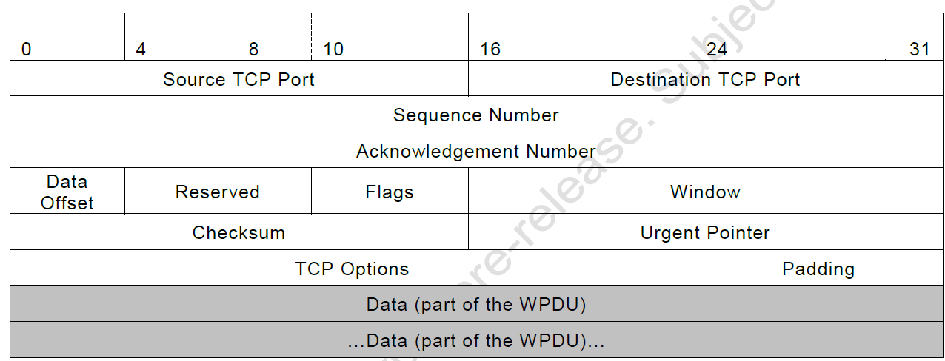
The DLMS/COSEM TCP-based transport layer protocol data unit
Notes:
http://www.tcpipguide.com/free/t_TCPMessageSegmentFormat-3.htm
http://www.tcpipguide.com/free/t_TCPMessageSegmentFormat-3.htm
Source Port: The 16-bit port number of the process that originated the TCP segment on the source device.
Destination Port: The 16-bit port number of the process that is the ultimate intended recipient of the message on the destination device.
Sequence Number: For normal transmissions, the sequence number of the first byte of data in this segment. In a connection request (SYN) message, this carries the initial sequence number (ISN) of the source TCP. The first byte of data will be given the next sequence number after the contents of this field,
Acknowledgment Number: When the ACK bit is set, this segment is serving as an acknowledgment (in addition to other possible duties) and this field contains the sequence number the source is next expecting the destination to send.
Data Offset: Specifies the number of 32-bit words of data in the TCP header. In other words, this value times four equals the number of bytes in the header, which must always be a multiple of four. It is called a “data offset” since it indicates by how many 32-bit words the start of the data is offset from the beginning of the TCP segment.
Reserved: 6 bits reserved for future use; sent as zero.
Window: Indicates the number of octets of data the sender of this segment is willing to accept from the receiver at one time. This normally corresponds to the current size of the buffer allocated to accept data for this connection. This field is, in other words, the current receive window size for the device sending this segment, which is also the send window for the recipient of the segment. See the data transfer mechanics topic for details.
Checksum: A 16-bit checksum for data integrity protection, computed over the entire TCP datagram plus a special “pseudo header” of fields. It is used to protect the entire TCP segment against not just errors in transmission, but also errors in delivery. Optional alternate checksum methods are also supported.
Urgent Pointer: Used in conjunction with the URG control bit for priority data transfer. This field contains the sequence number of the last byte of urgent data. See the priority data transfer topic for details
Padding: If the Options field is not a multiple of 32 bits in length, enough zeroes are added to pad the header so it is a multiple of 32 bits
Data: The bytes of data being sent in the segment.

Slide 40
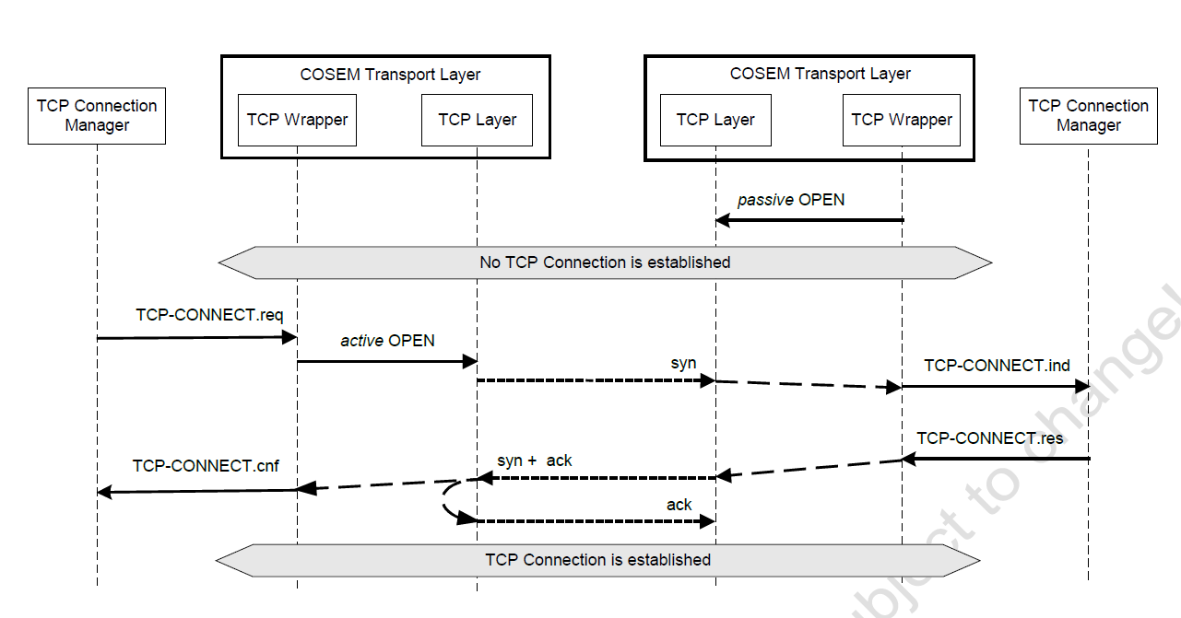
Definition of the procedures
TCP connection establishment
Notes:
The TCP connection is established using a three-way handshake mechanism, as described in STD0007. This requires three message exchanges as shown above and guarantees that both sides know that the other side is ready to transmit and also that the two sides are synchronized: the initial sequence numbers are agreed upon.
Both the client and server side TCP connection manager processes are allowed to initiate the TCP connection. To establish the connection, one of them plays the role of the initiator, and the other that 2580 of the responder.
In order to be able to respond, the responder has to perform a ‘passive’ opening before receiving the first, SYN packet.
To do this, it has to contact the local operating system (OS) to indicate, that it is ready to accept incoming connection requests. As the result of this contact, the OS assigns a TCP port number to that end-point of the connection and reserves the resources required for a future connection – but no message is sent out.
In the case of the DLMS/COSEM TCP-based TL, the wrapper sublayer initiates this passive opening autonomously during system initialisation. In other words, as this passive opening is the responsibility of the wrapper sublayer, no service is provided to an external entity to initiate the passive opening.
As both the client and the server side TCP connection manager processes are allowed to play the role of the “Responder” application, the TLs on both sides shall perform a passive opening during the system initialisation.

Slide 41
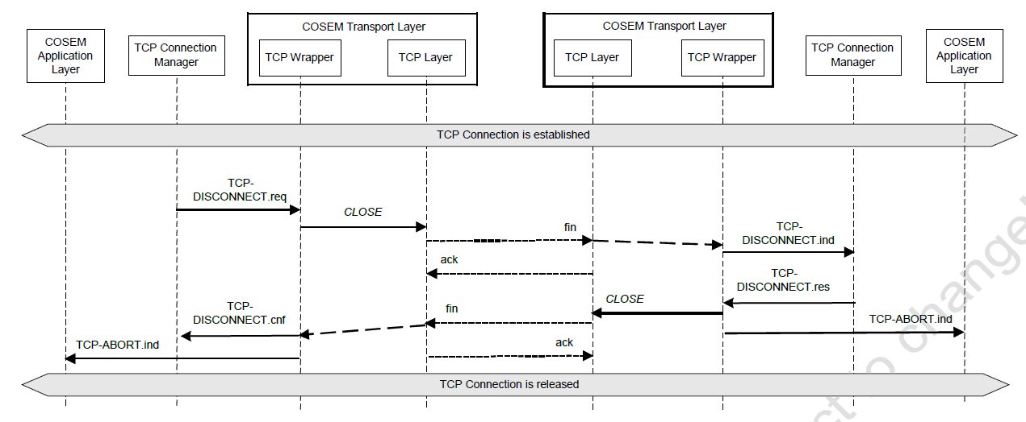
TCP disconnection
Notes:
The procedure can be initiated either by the client or the server side TCP connection manager process, by invoking the TCP-DISCONNECT.request primitive.
This request is transformed by the “wrapper” to a CLOSE () function call to the TCP interface.
The TCP sends a fin segment, which is acknowledged by the peer TCP . At the same time, through the wrapper, the TCP-DISCONNECT.indication primitive is generated, informing the user TCP connection manager that the connection is closing. The connection manager – in order to gracefully release the connection – responds with a TCP-DISCONNECT.response primitive.
The TCP wrapper calls the CLOSE function and the TCP sends out its fin segment. At the same time, the TCP wrapper indicates the closing of the TCP connection to the DLMS/COSEM AL using the TCP- ABORT.indication primitive.
On the requesting side, the TCP sends an acknowledgement and upon the reception of this by the peer the TCP connection is deleted. At the same time, the wrapper generates the TCP- DISCONNECT.confirm primitive informing the connection manager process that the disconnection request has been accepted. Similarly to the peer, the TCP disconnection is also indicated to the DLMS/COSEM AL with the help of the COSEM-ABORT.indication primitive.

Slide 42
TCP connection abort
The DLMS/COSEM TCP-based TL indicates the disruption or disconnection of the supporting TCP connection to the DLMS/COSEM AL with the help of the TCP-ABORT.indication primitive.
This is the only TCP connection management service provided to the DLMS/COSEM AL.
The service is invoked either when the TCP connection is disconnected by the TCP connection manager process or when the TCP disconnection occurs in a non-solicited manner, for example the TCP sublayer is detecting a non-resolvable error or the physical connection is shut down.
The purpose of this service is to inform the DLMS/COSEM AL about the disruption of the TCP connection, so that it could release all existing AAs.

Slide 43
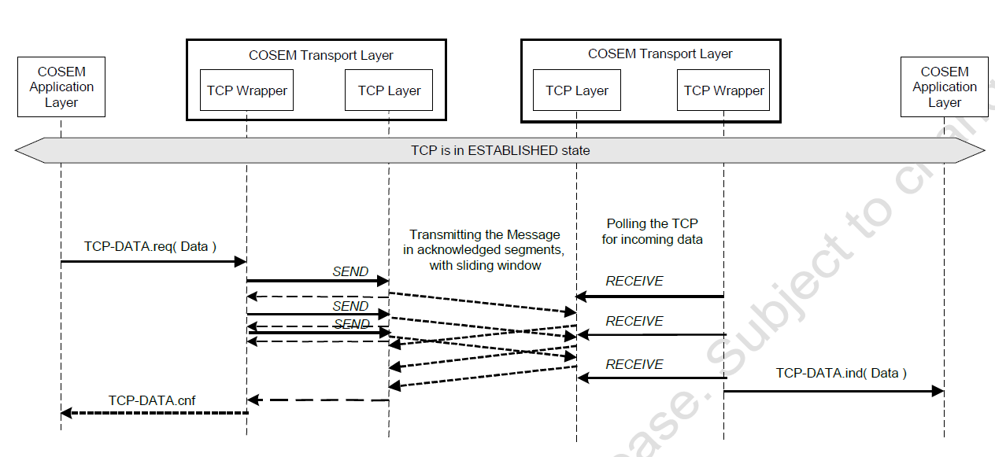
Data transfer using the COSEM TCP-based transport layer
Notes:
The optional TCP-DATA.confirm primitive indicates the result of the TCP-DATA.request primitive invoked previously, which is either OK or NOK.
However, the meaning of this result is implementation dependent. When the .confirm primitive is implemented as a local confirmation, the result indicates whether the DLMS/COSEM TL was able to buffer for sending or to send out the APDU or not.
When it is implemented as a remote confirmation, the result indicates whether the APDU has been successfully delivered to the destination or not.
As shown in Figure, the message (a WPDU) may be transported (sent / received) in more than one TCP packet. It is because TCP sends data as a stream of octets, without preserving data boundaries. It is the responsibility of the wrapper sublayer to hide this property of the TCP sublayer from the service user DLMS/COSEM AL. The sender side wrapper keeps track about the amount of data sent with one SEND() function call and repeats the operation until the whole WPDU is sent. The receiver side wrapper continues to receive incoming TCP packets until a complete WPDU is received.

Slide 44
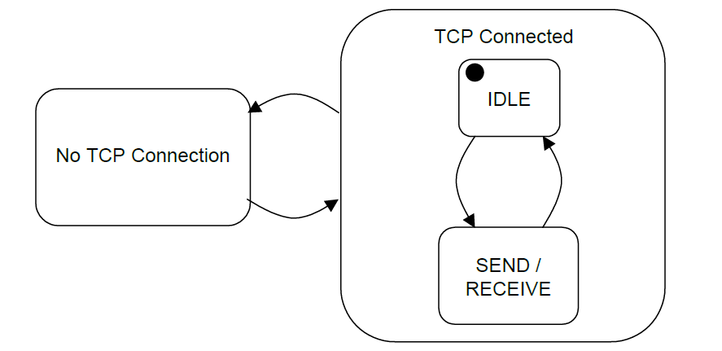
High-level state transition diagram of the wrapper sublayer
Notes:
In both macro-states – No TCP Connection and TCP Connected – the wrapper keeps polling the TCP layer for its connection status, and transits into the other macro-state if the status has changed.
The wrapper enters always into the IDLE sub-state of the TCP Connected state, and transits to the composite.
SEND/RECEIVE state either on a TCP-DATA.request or on the reception of a TCP packet. In this state, the wrapper sends and/or receives WPDUs

Slide 45
Converting OSI-style TL services to and from RFC-style TCP function calls
As specified in STD0007, a TCP connection is established by calling the OPEN function. This function can be called in active or passive manner.
According to the TCP connection state diagram (Figure) a passive OPEN takes the caller device to the LISTEN state, waiting for a connection request from any remote TCP and port.
An active OPEN call makes the TCP to establish the connection to a remote TCP.
The establishment of a TCP Connection is performed by using the so-called “Three-way handshake” procedure. This is initiated by one TCP calling an active OPEN and responded by another TCP, the one, which has already been called a passive OPEN and consequently is in the LISTEN state
The message sequence – and the state transitions corresponding to that message exchange – for this “three-way handshake” procedure are shown in Figure
Notes:
Sequence numbers are part of the TCP packet, and are
fundamental to reliable data transfer.

Slide 46
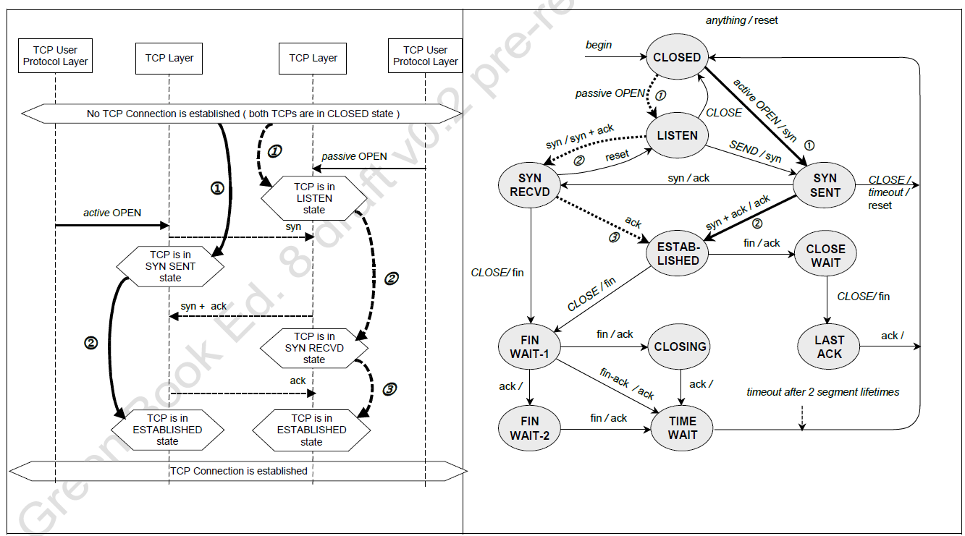
MSC and state transitions for establishing a transport layer and TCP connection
NOTE In the case of the COSEM transport layer, the TCP user protocol layer is the wrapper sublayer.
Notes:
A connection progresses through a series of states during its lifetime.
The states are: LISTEN, SYN-SENT, SYN-RECEIVED,ESTABLISHED, FIN-WAIT-1, FIN-WAIT-2, CLOSE-WAIT, CLOSING, LAST-ACK, TIME-WAIT, and the fictional state CLOSED. CLOSED is fictional because it represents the state when there is no TCB, and therefore, no connection. Briefly the meanings of the states are:
LISTEN - represents waiting for a connection request from any remote TCP and port.
SYN-SENT - represents waiting for a matching connection request after having sent a connection request.
SYN-RECEIVED - represents waiting for a confirming connection request acknowledgment after having both received and sent a connection request.
ESTABLISHED - represents an open connection, data received can be delivered to the user. The normal state for the data transfer phase of the connection.
FIN-WAIT-1 - represents waiting for a connection termination request from the remote TCP, or an acknowledgment of the connection termination request previously sent.
FIN-WAIT-2 - represents waiting for a connection termination request from the remote TCP.
CLOSE-WAIT - represents waiting for a connection termination request from the local user.
CLOSING - represents waiting for a connection termination request acknowledgment from the remote TCP.
LAST-ACK - represents waiting for an acknowledgment of the connection termination request previously sent to the remote TCP (which includes an acknowledgment of its connection termination request).
TIME-WAIT - represents waiting for enough time to pass to be sure the remote TCP received the acknowledgment of its connection termination request.
CLOSED - represents no connection state at all.
A TCP connection progresses from one state to another in response to events. The events are the user calls, OPEN, SEND, RECEIVE, CLOSE, ABORT, and STATUS; the incoming segments, particularly those containing the SYN, ACK, RST and FIN flags; and timeouts.
The state diagram in figure illustrates only state changes, together with the causing events and resulting actions, but addresses neither error conditions nor actions which are not connected with state changes. In a later section, more detail is offered with respect to the reaction of the TCP to events.
If one device setting up a TCP connection sends a SYN and then receives a SYN
from the other one before its SYN is acknowledged, the two devices perform a
simultaneous open, which consists of the exchange of two independent SYN and
ACK message sets. The end result is the same as the conventional three-way
handshake, but the process of getting to the ESTABLISHED state is different.
The possibility of collision normally occurs in Peer-2-Peer connection.
http://www.tcpipguide.com/free/t_TCPConnectionEstablishmentProcessTheThreeWayHandsh-3.htm

Slide 47
Closing a transport layer and a TCP connection
Closing a TCP connection is done by calling the CLOSE function, generally when there is no more data to be sent.
Upon the invocation of the TCP-DISCONNECT.request service primitive by the TCP connection manager process, the wrapper sublayer invokes the CLOSE function of the TCP sublayer.
However, as the TCP connection is full duplex, the other side may still have data to send. Therefore, after calling the CLOSE function, the TCP-based transport later may continue to receive data and send it to the DLMS/COSEM AL, until it is told that the other side has CLOSED, too.
At this point it generates the COSEM-ABORT.indication primitive, and all AAs are released.

Slide 48
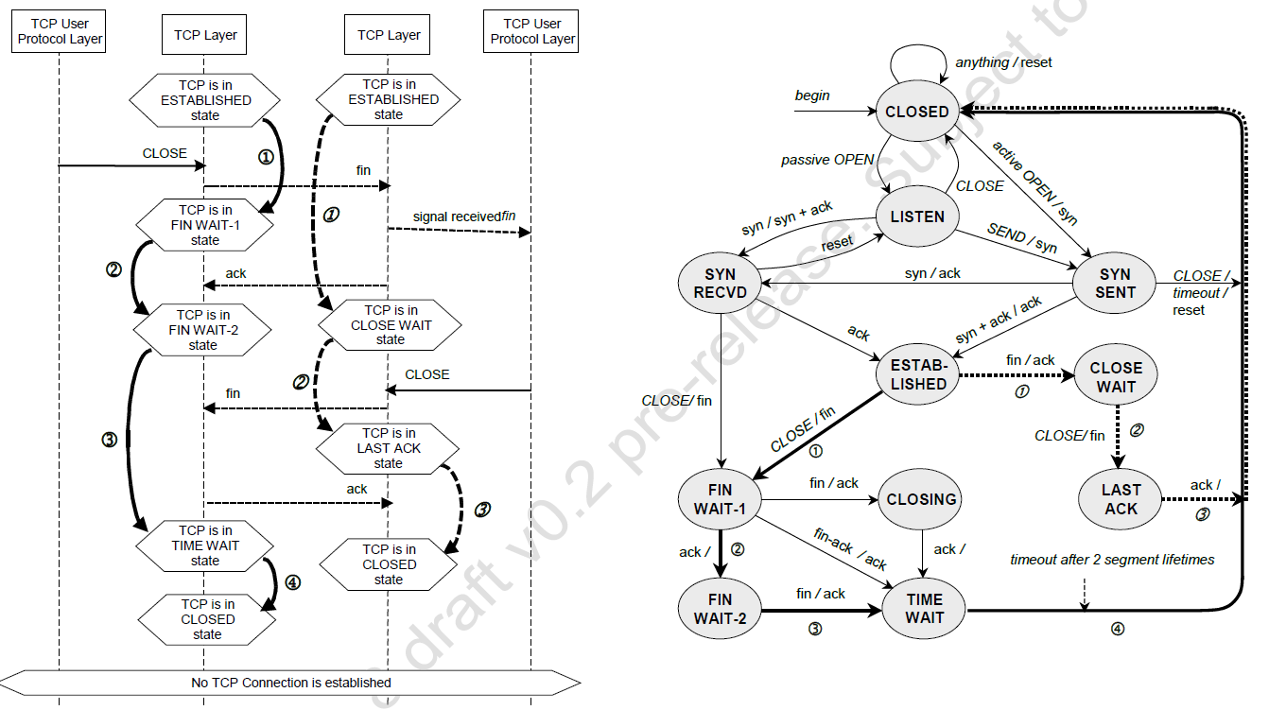
MSC and state transitions for closing a transport layer and TCP connection
Notes:
::http://www.tcpipguide.com/free/t_TCPConnectionTermination-2.htm
CLIENT
ESTABLISHED
Client Close Step #1 Transmit: The application using TCP signals that the connection is no longer needed. The client TCP sends a segment with the FIN bit set to request that the connection be closed.
FIN-WAIT-1
FIN-WAIT-1
The client, having sent a FIN, is waiting for it to both be acknowledged and for the serve to send its own FIN. In this state the client can still receive data from the server but will no longer accept data from its local application to be sent to the server.
FIN-WAIT-1
Client Close Step #2 Receive: The client receives the ACK for its FIN. It must now wait for the server to close.
FIN-WAIT-2
The client is waiting for the server's FIN.
FIN-WAIT-2
Server Close Step #1 Receive and Step #2 Transmit: The client receives the server's FIN and sends back an ACK.
TIME-WAIT
TIME-WAIT
The client waits for a period of time equal to double the maximum segment life (MSL) time, to ensure the ACK it sent was received.
TIME-WAIT
The timer expires after double the MSL time.
CLOSED
CLOSED
The connection is closed.

Slide 49
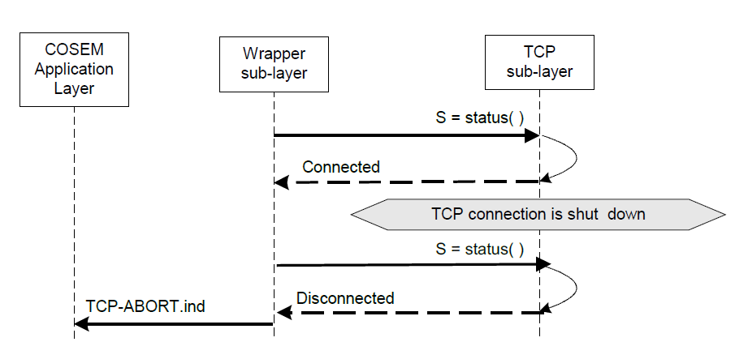
Polling the TCP sublayer for TCP abort indication
TCP connection abort
STD0007 does not specify a standard function to indicate an unexpected abort at TCP level. However, it can be detected by the TCP user entity by polling the status of the TCP with the STATUS() function, as shown in Figure

Slide 50
Data transfer using the TCP-DATA service
To send an APDU to the peer, the DLMS/COSEM AL simply invokes the TCP-DATA.request primitive of the DLMS/COSEM TCP-based TL.
Also, when a complete APDU is received, this is indicated to the COSEM AL with the help of the TCP-DATA.indication primitive. Thus, for the AL the TL behaves as if it would transport the whole APDU in one piece.
However, as TCP is a streaming protocol, not preserving data boundaries,nothing ensures that an APDU is actually transmitted in one TCP packet. As already mentioned in the DLMS/COSEM TCP-based TL it is the responsibility of the wrapper sublayer to “hide” the streaming nature of the TCP sublayer.
The following example illustrates how the wrapper sublayer accomplishes this task. Let’s suppose that an AL entity wants to send an APDU containing 992 bytes via the DLMS/COSEM TCP-based TL. It invokes the TCP-DATA.request service with this APDU as the DATA service parameter as shown in Figure .

Slide 51
Upon the reception of this service invocation, the wrapper sublayer constructs the WPDU:
it pre-fixes the APDU with the wrapper header (WH), including the local and remote wPort numbers and the APDU length.
It calls then the SEND() function of the TCP sublayer, requesting to send the WPDU, which is now 1000 bytes long: 8 bytes of wrapper header plus 992 bytes of APDU.
The SEND() function returns with the number of bytes sent or an error (a negative value). Let’s suppose that no error occurs and the SEND() function successfully returns with the value 476.
This number is the number of bytes sent. This also illustrates the meaning of the “streaming” nature of the TCP: in fact, the SEND() function returns with success even if the number of bytes sent is less than the number of bytes requested to be sent.

Slide 52
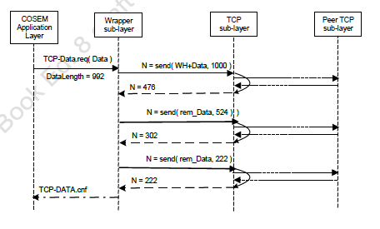
Sending an APDU in three TCP packets

Slide 53
From the value returned, the wrapper knows that not the whole WPDU has been sent.
It calls the SEND() function again, with the remaining part of the WPDU and so on, until the complete WPDU is sent.
As already mentioned in depending on the implementation, the successful return of the SEND() function may even not mean that something has been really sent to the network.
It may mean only that the protocol implementation took and buffered the data. It may happen that the protocol implementation delays the transmission to comply with protocol conventions or network traffic related algorithms.
On the receiving side, it is also the responsibility of the wrapper sublayer to assemble the complete APDU before invoking the TCP-DATA.indication primitive.
This is possible by using the length bytes of the WPDU header. The wrapper repeats RECEIVE() calls until the number of bytes, indicated in the WPDU header is received.
All these SEND() and RECEIVE() calls are internal to the DLMS/COSEM TL. The service user DLMS/COSEM AL simply uses the TCP-DATA services, and observes a reliable data transfer service preserving the data boundaries of the APDUs

Slide 54
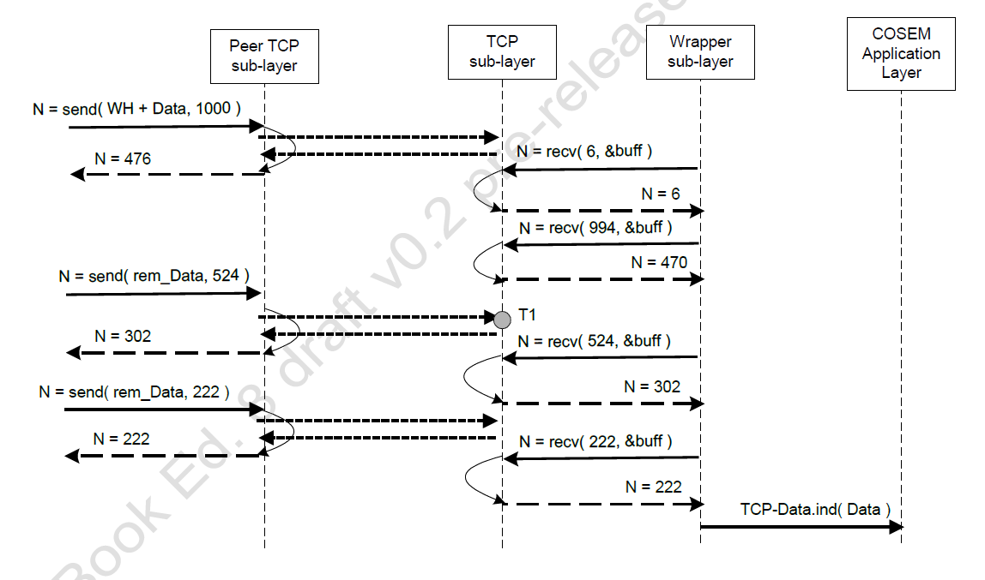
Receiving the message in several packets
Notes:
NOTE: As calling the RECEIVE() function is asynchronous with regard to the TCP communications, it is perfectly possible, that the receiver calls the RECEIVE() function at a moment, when the reception of a TCP packet is in progress ( T1. on the Figure above) – or even if when no characters have been received since the last RECEIVE() call. It does not lead to erroneous reception: it increases only the number of necessary RECEIVE() function calls to get the complete message.
NOTE : It is also possible that one or more SEND() calls result in sending more than one TCP packet. It does not lead to erroneous reception either: sooner or later, the receiver gets the whole message.

